Slide 1
Document-Level Multi-Aspect Sentiment Classification for Online Reviews of Medical Experts
ADVISOR:JIA-LING KOH
SOURCE:CIKM 19
SPEAKER:LI-WEI LiU
DATA:2020/05/11

Slide 2
OUTLINE
Introduction
Method
Experiment
Conclusion

Slide 3
INTRODUCTION
Online doctor review system:
Provide a platform for doctors and patients to operate and select
Patient comments on the doctor
https://www.ratemds.com/
Notes:
提供一個平台讓醫生跟患者能夠經營及挑選
rating跟患者給予的評論是相關的，所以我們目的要透過評論預測rating

Slide 4
INTRODUCTION
Goal:
Automatically score through patient comments on doctors
For multiple aspects respectively
Document-Level Multi-Aspect Sentiment Classification(DLMASC)
Notes:
醫生可以透過看到關鍵字知道改善的點
患者可以透過關鍵字搜尋自己喜好的醫生

Slide 5
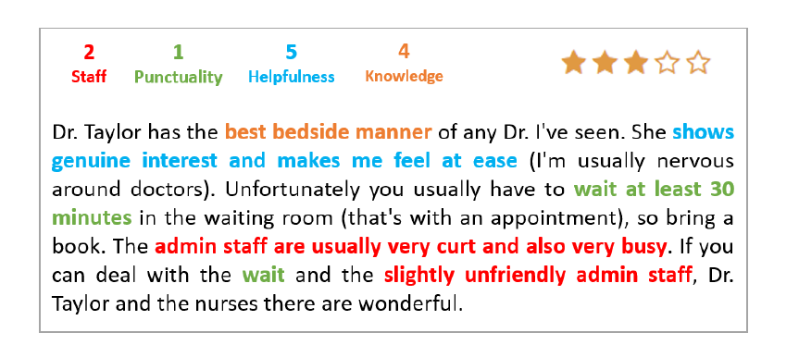
INTRODUCTION
Document-Level Multi-Aspect Sentiment Classification(DLMASC)
Output:
Rating for each aspect
Input:
A review
(Patient comments on the docto)

Slide 6
OUTLINE
Introduction
Method
Experiment
Conclusion

Slide 7
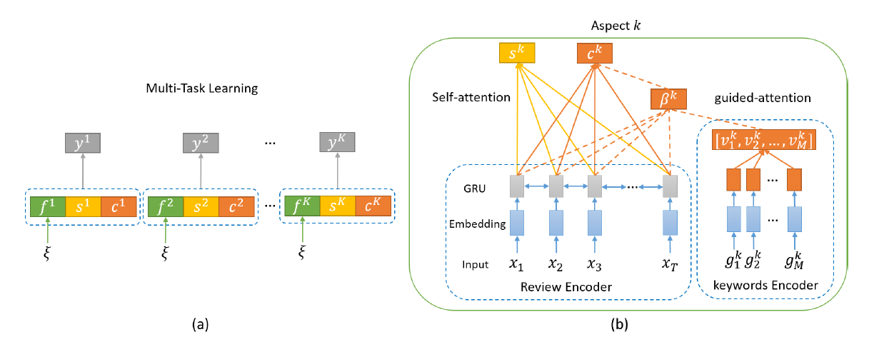
FRAMEWORK
Multiple tasks, shared parameters
predict rating
features of doctors
reviews
aspect-keywords
How to get?
keywords for aspect k

Slide 8
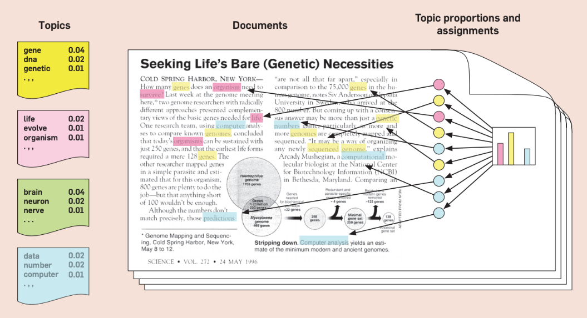
METHOD Discover Aspect-Keywords
Latent Dirichlet Allocation(LDA) – Unsupervised
Find the most relevant top-k keywords
Notes:
每篇文件都是由數個「主題 (Topic)」所組成 (以我們的論文來看就是aspect)
這個例子地topic分成 粉色 黃色 藍色 三種

Slide 9
METHOD Discover Aspect-Keywords
In our dataset…
Notes:
考慮到不同專業的醫生的關鍵字可能會有所不同，所以分開處理
這篇paper採用的醫生種類也只採用這3個

Slide 10
METHOD for aspect k
Review Encoder
Input: review X(x₁,x₂,…,x_{T})
Enbedding: (E_{x1},E_{x2},…,E_{xT}) where E_{xt} is the word vector of x_{t}
Bi-directional GRU: hidden states H=(h₁,h₂,…,h_{M})
Notes:
M應該要等於T

Slide 11
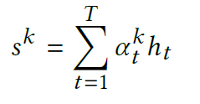
METHOD for aspect k
Multi-Aspect Self-Attention
Determine attention weights α^{k}_{t}
of each token in the review
Representation of the review : sum of all hidden states

Slide 12
METHOD for aspect k
Aspect-Keywords Guided-Attention
Given a list of aspect-keywords for aspect k:
(g^{k}₁, g^{k}₂, ..., g^{k}_{M})
And enbedding as: (Eg^{k}₁, Eg^{k}₂, …, Eg^{k}_{M})
Each word vector is transformed into a hidden state with:
Z_{t}
r_{t}

Slide 13
METHOD for aspect k
Aspect-Keywords Guided-Attention
Concatenating all hidden states into a single vector
v^{k}=[v^{k}₁ ,v^{k}₂ , ...,v^{k}_{M}]
Calculate alignment scores between encoded vectors of aspect-keywords and tokens in the review as:
The guided-attention weights and vector representation of the review:
Notes:
vector representation of the review 可表示aspect k 在該review 的keywords分布

Slide 14
METHOD for aspect k
Aspect-Specific Feature Encoder
We embed one hot representations of features of doctors
into a continuous vector space for each aspect k as
Feature of doctors : specialties, insurance plans, locations, genders and facilities
Notes:
專業類別、健保項目、地點(都市、鄉下…)、性別、設施類別(大醫院、診所、急救護理中心)

Slide 15
METHOD for aspect k
Multi-Aspect Rating Prediction
Classifier to predict rating:
A single layer feed-forward network with a softmax activation function
Integer score from 1 to 5

Slide 16
METHOD
Loss function
Score from 1 to 5
Parameter set including all weight matrices and bias vectors
Notes:
Cross entropy

Slide 17
OUTLINE
Introduction
Method
Experiment
Conclusion

Slide 18
EXPERIMENT DataSets
ratemds-us and ratemds-ca
90% of reviews are from these two countries
 | reviews | doctors
ratemds-us | 1,414,235 | 385,407
ratemds-ca | 1,252,941 | 99,719
Randomly split each dataset into training/development/testing sets at the ratio of 0.8/0.1/0.1.

Slide 19
EXPERIMENT
Comparison with Previous Models (‘Macro’ avg F-score and MSE)
Notes:
MAJOR:只用review的topic預測，沒用到review本身的文本
GLVL: 使用文本，但是使用文本中的keywords vector的平均當作review的representation
BOWL:用Bag of words，與前者都使用線性分類器(LINLINEAR)
CNN:經過CNN的max pooling出來的feature，將所有filter的feature concated起來 當作review的representation
GRU: 使用最後一層hidden state ，concated起來(因為是雙向的 所以有2個hidden states)
GRU-ATN:使用公式一的attention
MT-BASE:multi-task learning only review encoder + self-attention (s)
MT-FEAT:multi-task learning review encoder + self-attention (s) +features of doctors (f)

Slide 20
EXPERIMENT
Comparison with Previous Models (‘Macro’ avg F-score and MSE)
Notes:
MAJOR:只用review的topic預測，沒用到review本身的文本
GLVL: 使用文本，但是使用文本中的keywords vector的平均當作review的representation
BOWL:用Bag of words，與前者都使用線性分類器(LINLINEAR)
CNN:經過CNN的max pooling出來的feature，將所有filter的feature concated起來 當作review的representation
GRU: 使用最後一層hidden state ，concated起來(因為是雙向的 所以有2個hidden states)
GRU-ATN:使用公式一的attention
MT-BASE:multi-task learning only review encoder + self-attention (s)
MT-FEAT:multi-task learning review encoder + self-attention (s) +features of doctors (f)

Slide 21
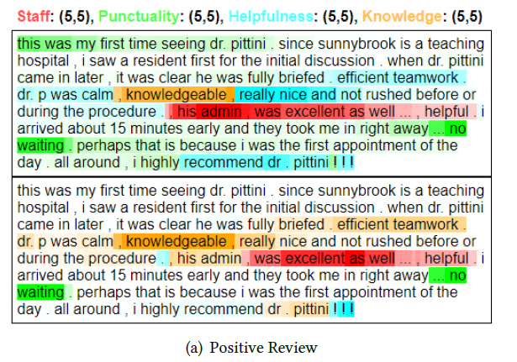
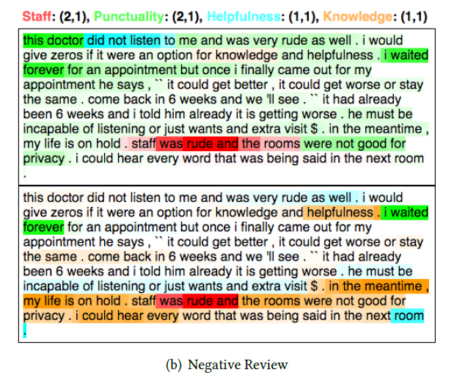
EXPERIMENT
Attention Visualization
(ground-truth,predicted rating)
Self-ATT
weight
Guided-ATT
weight

Slide 22
EXPERIMENT
Attention Visualization
See Figure 7
Failure of attention may be caused by:
Short Review or does not cover all aspects.
May be mixed with unrelated sentences.
Many keywords and phrases are ambiguous in different context.
Notes:
review過短者沒有涵蓋所有aspect。
可能夾雜著無關的語句。
許多關鍵字和短語在不同的上下文中意思是不同的。

Slide 23
OUTLINE
Introduction
Method
Experiment
Conclusion

Slide 24
CONCLUSION
We attempted to explore content of reviews by extracting aspect-keywords with the topic modeling.
The proposed model takes both features of doctors and aspect-keywords into consideration.
We proposed a multi-task learning framework for the document-level multi-aspect sentiment classification.
Notes:
我們嘗試通過使用主題建模提取方面關鍵字來探索評論的內容
提出的模型同時考慮了醫生和方面關鍵詞的特徵。
我們為文檔級多方面情感分類提出了一個多任務學習框架

